Slide 1

Navigation by Reinforcement Learning
3D Vision Project by Varin Buff, Gian-Andrea Heinrich, Björn Joos, Robin Stähli
Supervisor: Nikolay Savinov

Slide 2
INFOINFOINFO
Timeline comparision
Group setup
Achievments
Issues

Slide 3
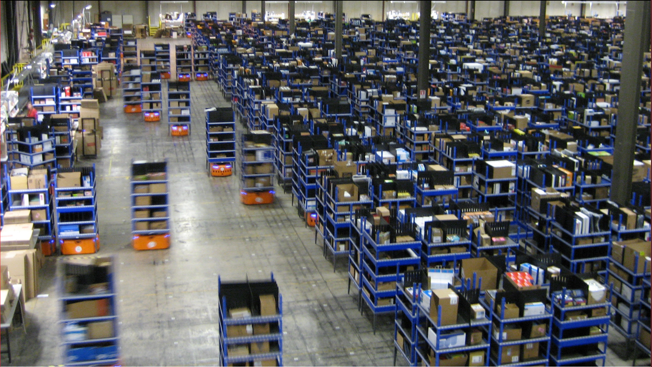
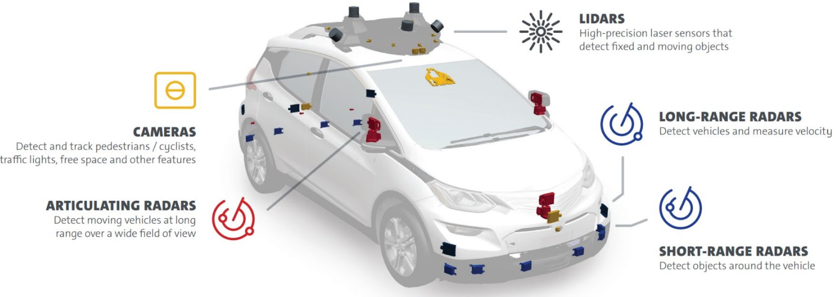
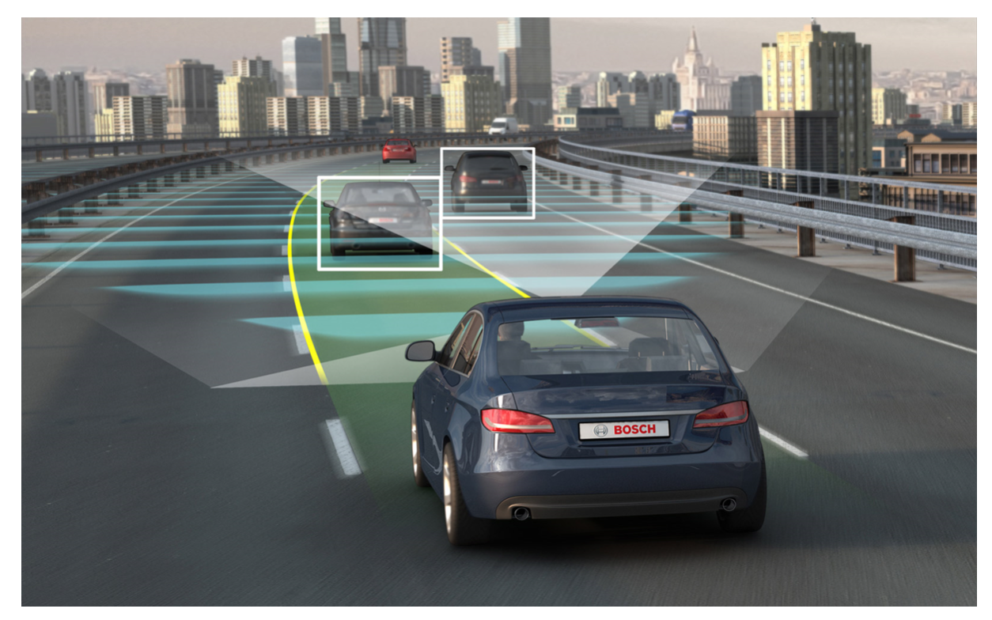
Why is it important?
In Industry 4.0 and in the car of the future navigation is crucial
Vision based navigation by reinforcement learning allows to use relay on cameras instead of expensive large and heavy high-tech gear.
http://urbanizehub.com/wp-content/uploads/2017/10/kiva.jpg (11.03.2018)
http://scet.berkeley.edu/cities-autonomous-vehicles/ (11.03.2018)
http://image-sensors-world.blogspot.ch/2018/01/gm-self-driving-car-has-5-lidars-and-16.html (11.03.2018)
Notes:
Erklären wieso wichtig → z.B. Lagerroboter in modernem Lagerhaus
Auto im Stadtverkehr
Einsparungen an Sensoren → Platz und Kosten

Slide 4
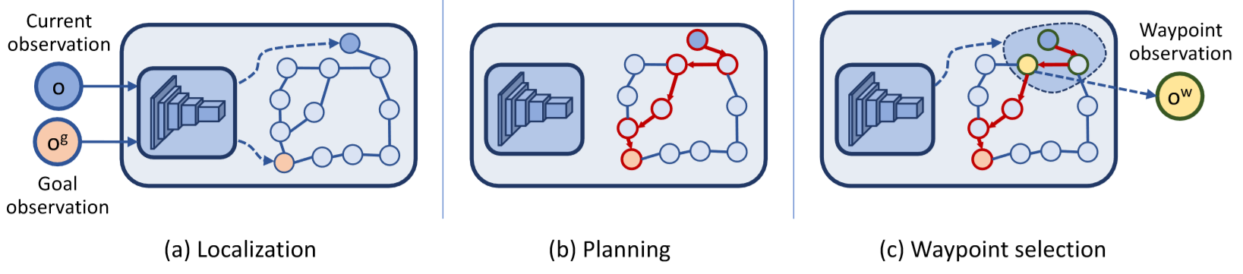
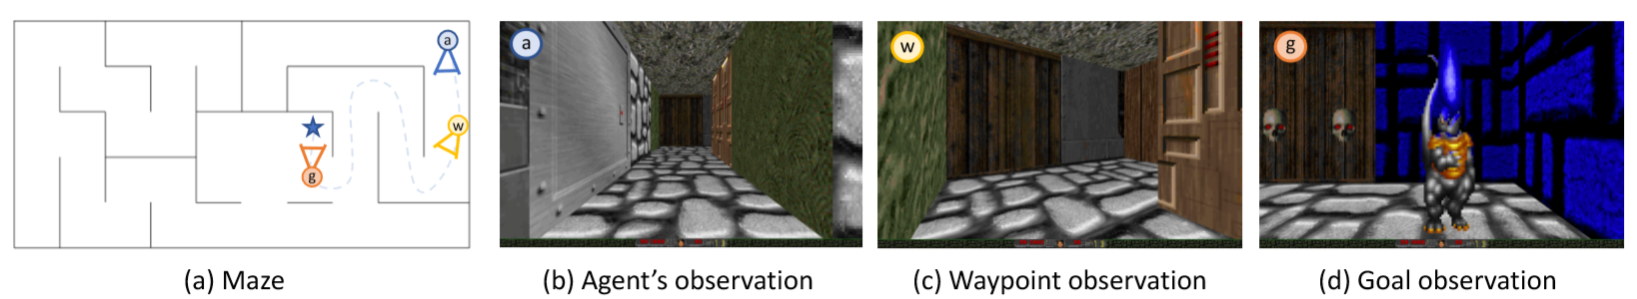
Semi-Parametric Topological Memory Approach for Navigation [1] Nikolay Savinov, Alexey Dosovitskiy, Vladlen Koltun
Waypoint observation
Navigating in Vizdoom mazes just by “watching” a video from this maze
Only 5 minutes of footage needed
Non-metric approach → comparable to animal brains [2]
Deep network retrieves nodes from the observations
Up to three times higher success rate than representative state of the art baselines
Scheme of the functioning principle of SPTM
The Principle shown in the working surroundings
[1] Savinov, N., Dosovitskiy, A., and Koltung, V.: ‘Semi-Parametric Topological Memory for Navigation’, ICLR 2018
[2] Foo, P., Warren, W.H., Duchon, A., and Tarr, M.J.: ‘Do humans integrate routes into a cognitive map?
Map- versus landmark-based navigation of novel shortcuts’, J. Exp. Psychol.-Learn. Mem. Cogn., 2005, 31, (2), pp. 195-215

Slide 5
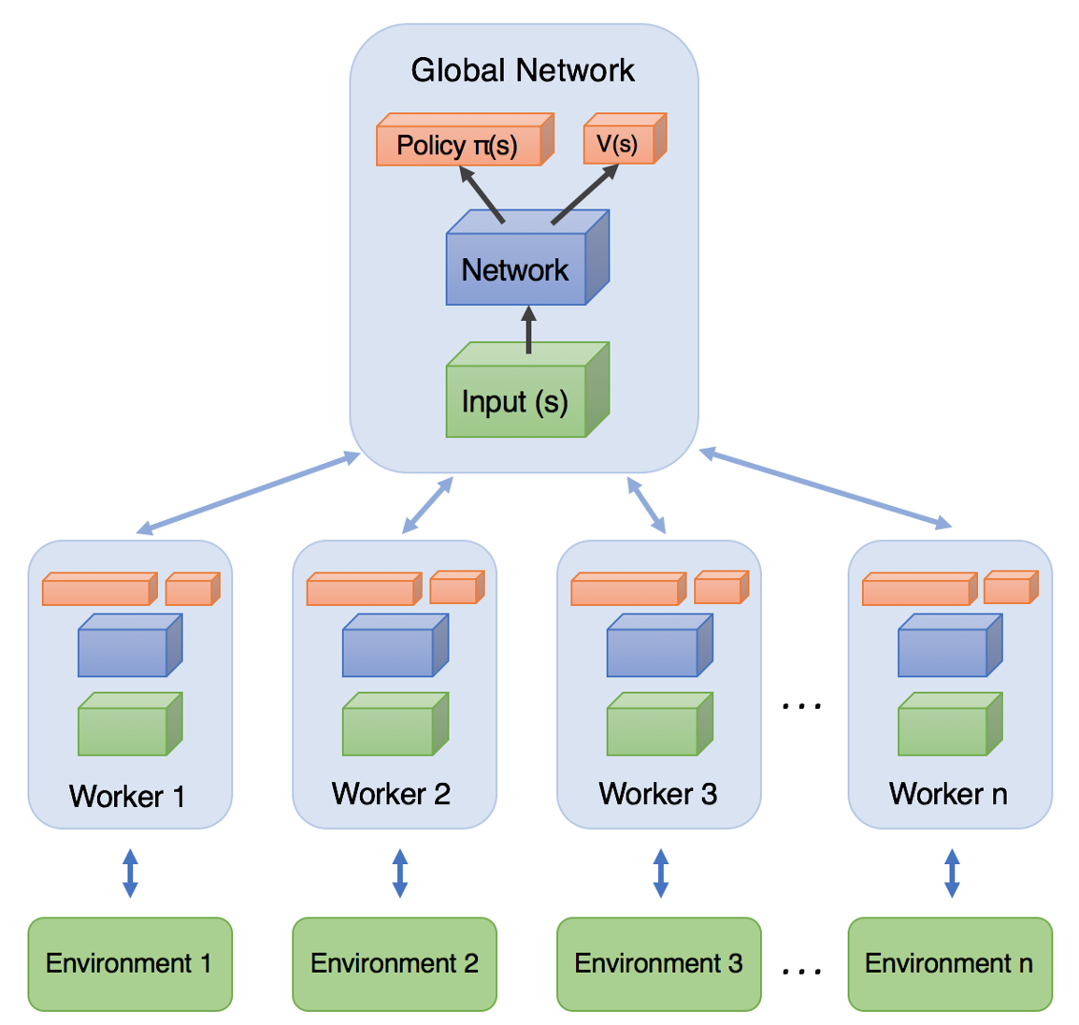
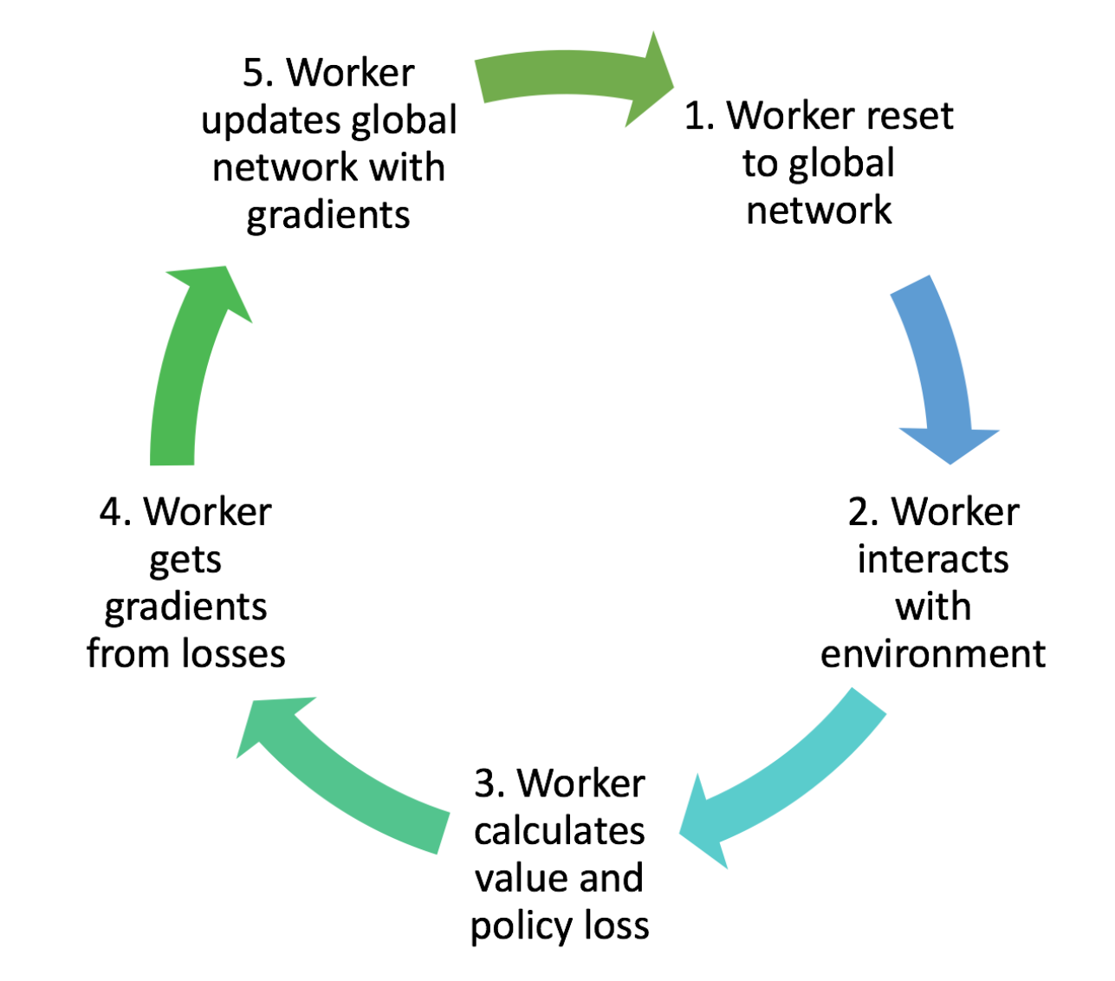
Our Task
Working into the topic
Get a training/testing environment running as described by Savinov et al. [1]
Evaluate and compare an agent using the A3C [2] algorithm to the SPTM approach and the base lines in Savinov et al. [1]
As crowning touch if there is time left we will do the same with the PPO [3] algorithm
Training Workflow and Diagramm of A3C high-level achitecture → Asynchronous Advantage Actor-Critic
[1] Savinov, N., Dosovitskiy, A., and Koltung, V.: ‘Semi-Parametric Topological Memory for Navigation’, ICLR 2018
[2] Mnih, V., Badia, A., Mirza, M., Graves, A., Harley, T., Lillicrap, T., Silver, D., and Kavukcuoglu, K.: ‘Asynchronous Methods
for Deep Reinforcement Learning’, 2016
[3] Schulmann, J., Wolski, F., Dharivwal, P., Radford, A., and Klimov, O.: ‘Proximal Policy Optimization Algorithms’,
Corr, 2017, abs/1707.06347
https://medium.com/emergent-future/simple-reinforcement-learning-with-tensorflow-part-8-asynchronous-actor-critic-agents-a3c-c88f72a5e9f2 (11.03.2018)
Notes:
Für A3C gute Erklärung auf dem Link!
Erklärung für PPO dürfte zu viel sein

Slide 6
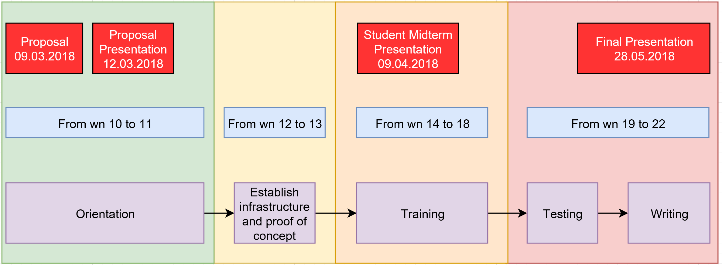
Work Packages and Timeline
Division into two main tasks
Infrastructure Group
Deployment of software on Leonhard
Program interface to react between agent and ViZDoom environment
Providing support to the evaluation group
Evaluation Group
Implement A3C for our needs
Training: RL based “walking” & video
Validation: changed textures
Testing

Slide 7


Slide 8
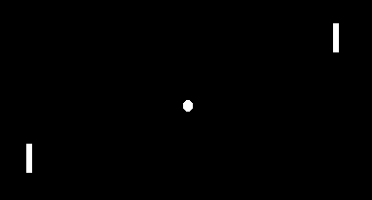
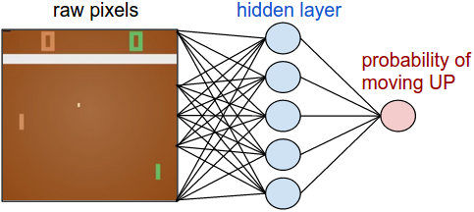
PPO (Proximal Policy Optimization)
PPO
Standard policy gradient methods have one gradient update per data sample
PPO enables multiple epochs of minibatch updates
Results in better performance
Images: http://karpathy.github.io/2016/05/31/rl/ (11.03.18)
Notes:
Lausige Backup Folie

Slide 9
Open Questions
How to save the current (GPU) state and recover it later on
Tensorforce/Tensorflow → API
A3C
PPO → PPO2 (GPU Version, approximately 3x faster)
Savinov’s SPTM software package [1]
[1] https://github.com/nsavinov/SPTM (11.03.18)

